Slide 1

Linear Programming
MTH 564 – Mathematical Modeling

Slide 2

Example: Farming
A family farm has 625 acres available for planting. The family is considering planting corn, wheat, and oats. It is anticipated that 1,000 acre-ft of water will be available for irrigation, and the farmers will be able to devote 300 hours of labor per week. Additional data is presented in the table below. Find the amount of each crop that should be planted for maximum profit.
Requirement (per acre) | Corn | Wheat | Oats
Irrigation (acre-ft) | 3.0 | 1.0 | 1.5
Labor (hrs/week) | 0.8 | 0.2 | 0.3
Yield ($) | 400 | 200 | 250

Slide 3

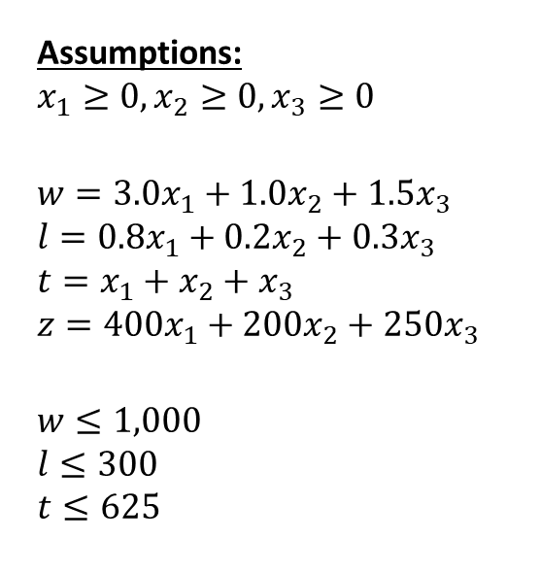
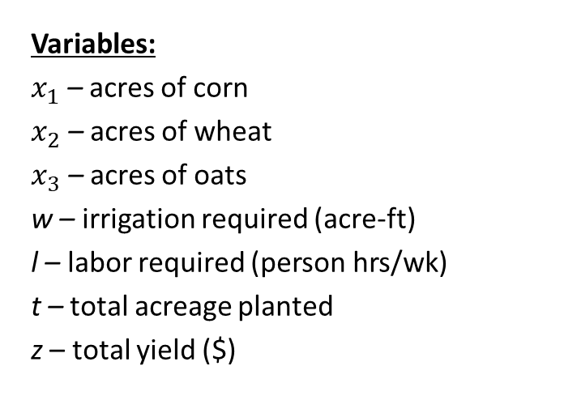
Step 1: Ask the question.
Let’s check units.
Variables:
$x_{1}$ – acres of corn
$x_{2}$ – acres of wheat
$x_{3}$ – acres of oats
w – irrigation required (acre-ft)
l – labor required (person hrs/wk)
t – total acreage planted
z – total yield ($)
Assumptions:
$$x_{1}≥0, x_{2}≥0, x_{3}≥0$$
$$w=3.0x_{1}+1.0x_{2}+1.5x_{3}$$
$$l=0.8x_{1}+0.2x_{2}+0.3x_{3}$$
$$t=x_{1}+x_{2}+x_{3}$$
$$z={400x}_{1}+{200x}_{2}+{250x}_{3}$$
$$w≤1,000$$
$$l≤300$$
$$t≤625$$
Objective
Maximize $z$

Slide 4
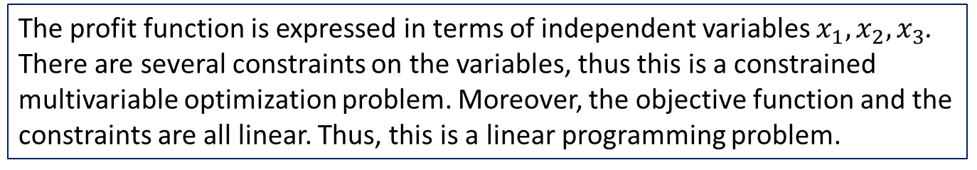

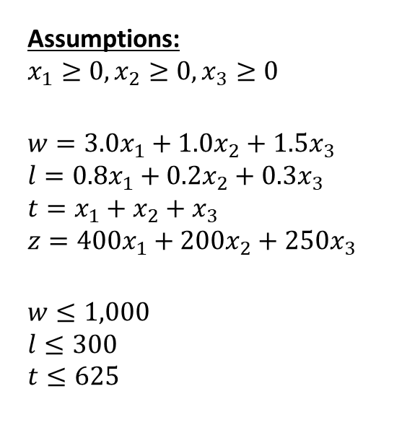
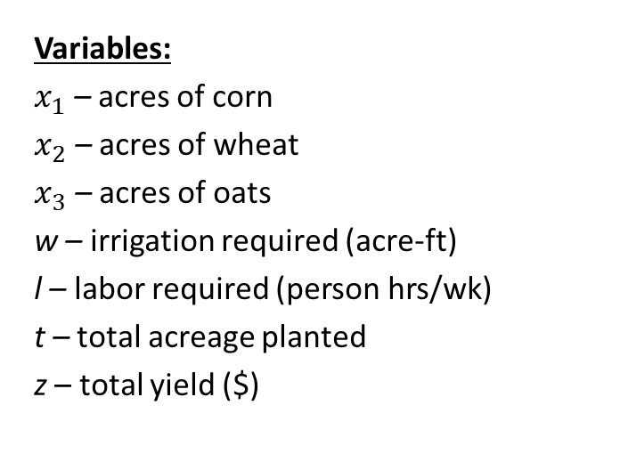
Step 2: Select the modeling approach
Variables:
$x_{1}$ – acres of corn
$x_{2}$ – acres of wheat
$x_{3}$ – acres of oats
w – irrigation required (acre-ft)
l – labor required (person hrs/wk)
t – total acreage planted
z – total yield ($)
Assumptions:
$$x_{1}≥0, x_{2}≥0, x_{3}≥0$$
$$w=3.0x_{1}+1.0x_{2}+1.5x_{3}$$
$$l=0.8x_{1}+0.2x_{2}+0.3x_{3}$$
$$t=x_{1}+x_{2}+x_{3}$$
$$z={400x}_{1}+{200x}_{2}+{250x}_{3}$$
$$w≤1,000$$
$$l≤300$$
$$t≤625$$
Objective
Maximize $z$
The profit function is expressed in terms of independent variables $x_{1}, x_{2}, x_{3}$. There are several constraints on the variables, thus this is a constrained multivariable optimization problem. Moreover, the objective function and the constraints are all linear. Thus, this is a linear programming problem.

Slide 5
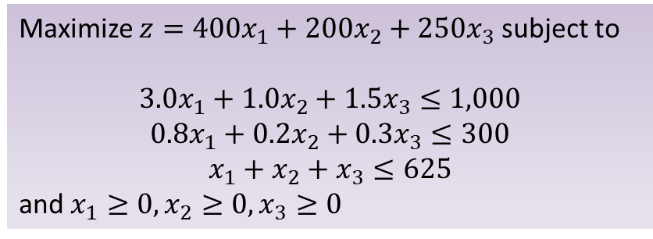

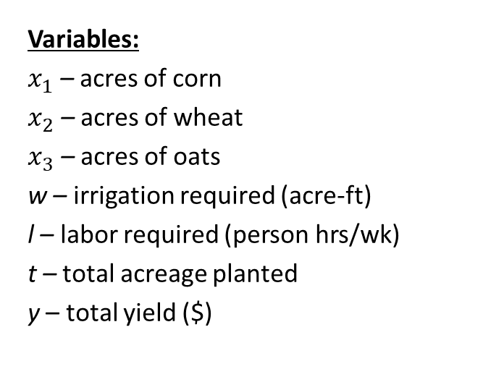
Step 3: Formulate the Model
Variables:
$x_{1}$ – acres of corn
$x_{2}$ – acres of wheat
$x_{3}$ – acres of oats
w – irrigation required (acre-ft)
l – labor required (person hrs/wk)
t – total acreage planted
y – total yield ($)
Assumptions:
$$x_{1}≥0, x_{2}≥0, x_{3}≥0 \\ w=3.0x_{1}+1.0x_{2}+1.5x_{3}$$
$$l=0.8x_{1}+0.2x_{2}+0.3x_{3}$$
$$t=x_{1}+x_{2}+x_{3}$$
$$z={400x}_{1}+{200x}_{2}+{250x}_{3}$$
$$w≤1,000$$
$$l≤300$$
$$t≤625$$
Objective
Maximize $z$
Maximize $z={400x}_{1}+{200x}_{2}+{250x}_{3}$ subject to
$$3.0x_{1}+1.0x_{2}+1.5x_{3}≤1,000$$
$$0.8x_{1}+0.2x_{2}+0.3x_{3}≤300$$
$$x_{1}+x_{2}+x_{3}≤625$$
and $x_{1}≥0, x_{2}≥0, x_{3}≥0$

Slide 6
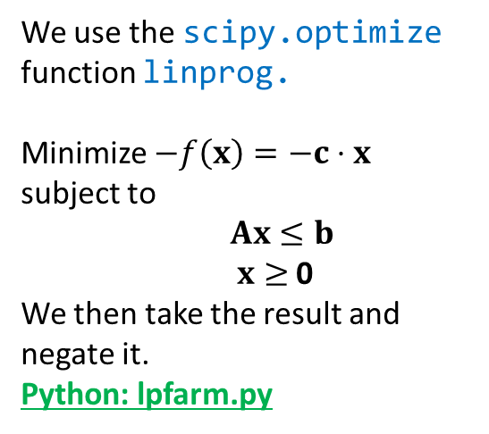
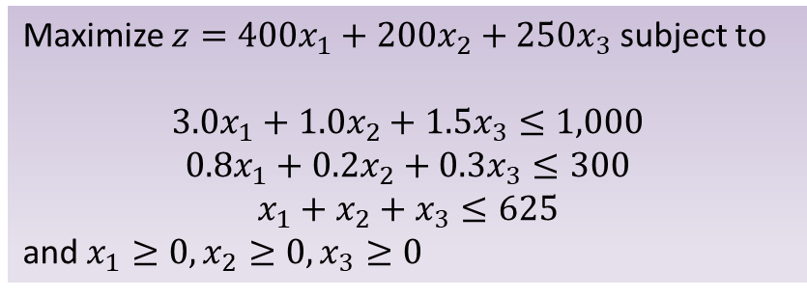
Step 4: Solve the Problem
We use the scipy.optimize function linprog.
Minimize $−f\left(x\right)=−c⋅x$ subject to
$Ax≤b$ $x≥$ 0
We then take the result and negate it. Python: lpfarm.py
Maximize $z={400x}_{1}+{200x}_{2}+{250x}_{3}$ subject to
$$3.0x_{1}+1.0x_{2}+1.5x_{3}≤1,000$$
$$0.8x_{1}+0.2x_{2}+0.3x_{3}≤300$$
$$x_{1}+x_{2}+x_{3}≤625$$
and $x_{1}≥0, x_{2}≥0, x_{3}≥0$
Consider the problem above
We use c = [-400,-200,-250].
b = [1000, 300, 625] is a list of upper bounds for the constraints
A = [[3, 1, 1.5], [0.8, 0.2, 0.3], [1, 1, 1]] represents the matrix for the constraints.
All the variables are bounded below by 0.
Notes:
See python file section1-1pig.py

Slide 7
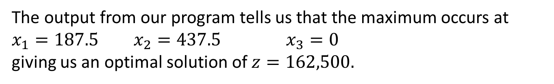
Step 4: Solve the Problem
The output from our program tells us that the maximum occurs at
$x_{1}=187.5$ $x_{2}=437.5$ $x_{3}=0$
giving us an optimal solution of $z=162,500.$
We also have the value of the slack variables:
$s_{1}=0$ $s_{2}=62.5$ $s_{3}=0$
Notes:
See python file section1-1pig.py

Slide 8
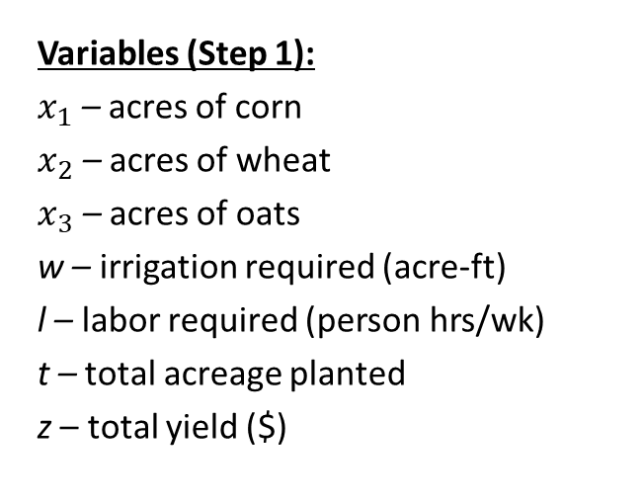
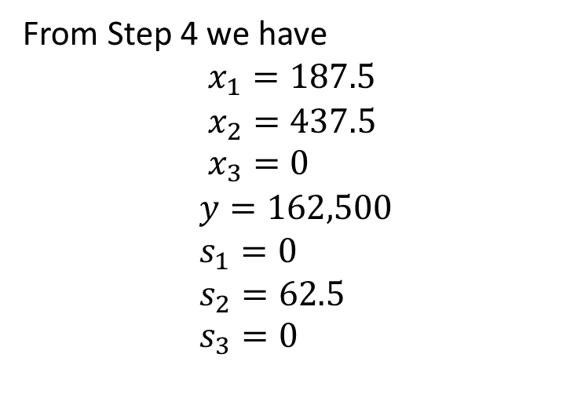
Step 5: Answer the question
From Step 4 we have
$$x_{1}=187.5$$
$$x_{2}=437.5 \\ x_{3}=0$$
$$y=162,500 \\ s_{1}=0 \\ s_{2}=62.5 \\ s_{3}=0$$
Variables (Step 1):
$x_{1}$ – acres of corn
$x_{2}$ – acres of wheat
$x_{3}$ – acres of oats
w – irrigation required (acre-ft)
l – labor required (person hrs/wk)
t – total acreage planted
z – total yield ($)
The optimal solution is to plant 187.5 acres of corn, 437.5 acres of wheat, and no oats. This should yield $162,500. The optimal solution uses all 1,000 acre-ft of irrigation and all 625 acres. Of the 300 available person-hours of labor per week 62.5 are unused.
Notes:
See python file section1-1pig.py

Slide 9
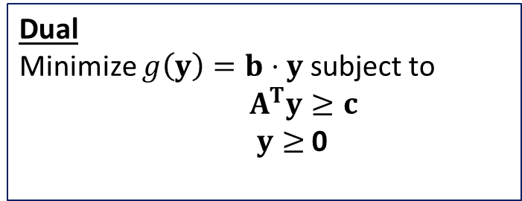
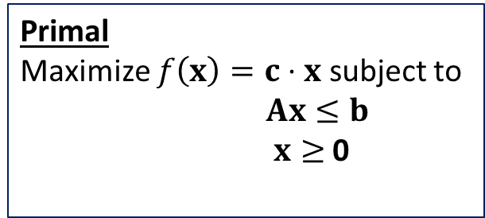
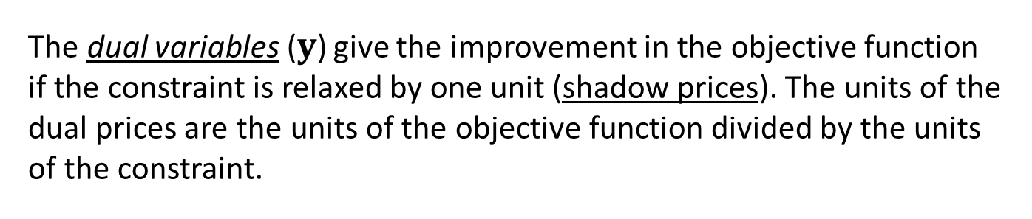
Duality and Shadow Prices
Duality
For an Linear Programming (LP) problem there is closely related LP problem called the dual. The solution to the dual problem provides useful information about the original LP problem, called the primal.
Primal
Maximize $f\left(x\right)=c⋅x$ subject to
$Ax≤b$ $x≥$ 0
Dual
Minimize $g\left(y\right)=b⋅y$ subject to
$A^{T}y≥c$ $y≥$ 0
The dual variables ($y$) give the improvement in the objective function if the constraint is relaxed by one unit (shadow prices). The units of the dual prices are the units of the objective function divided by the units of the constraint.

Slide 10
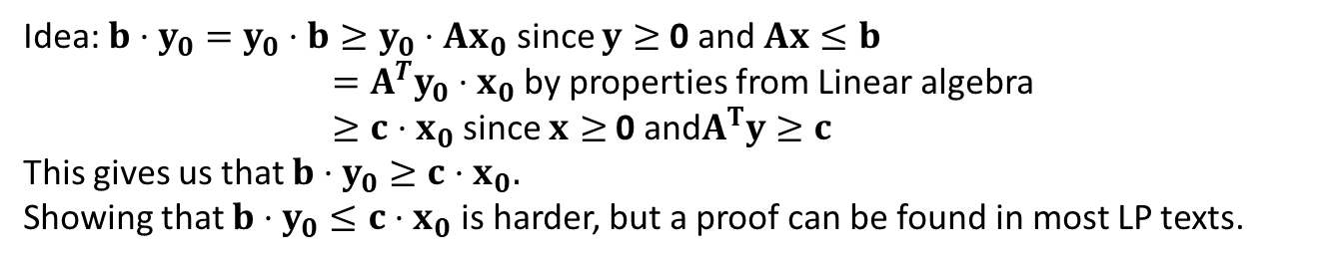
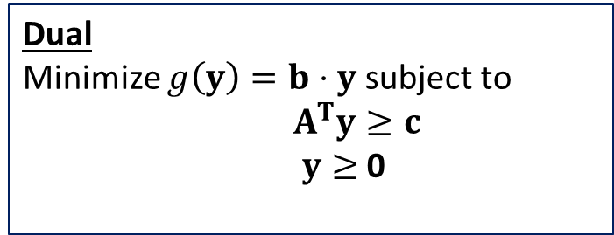

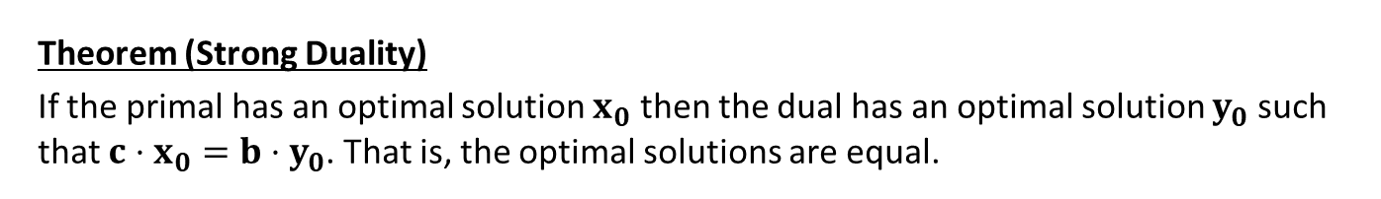
Strong Duality Theorem
Theorem (Strong Duality)
If the primal has an optimal solution $x_{0}$ then the dual has an optimal solution $y_{0}$ such that $c⋅x_{0}=b⋅y_{0}$. That is, the optimal solutions are equal.
Primal
Maximize $f\left(x\right)=c⋅x$ subject to
$Ax≤b$ $x≥$ 0
Dual
Minimize $g\left(y\right)=b⋅y$ subject to
$A^{T}y≥c$ $y≥$ 0
Idea: $b⋅y_{0}=y_{0}⋅b≥y_{0}⋅Ax_{0}$ since $y≥$ 0 and $Ax≤b$
$={A^{T}y}_{0}⋅x_{0}$ by properties from Linear algebra
$≥c⋅x_{0}$ since $x≥$ 0 and$A^{T}y≥c$
This gives us that $b⋅y_{0}≥c⋅x_{0}.$
Showing that $b⋅y_{0}≤c⋅x_{0}$ is harder, but a proof can be found in most LP texts.

Slide 11
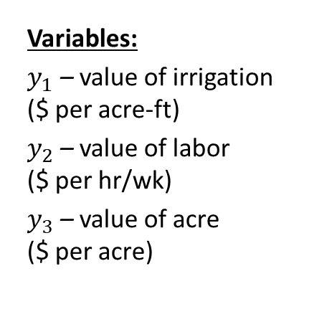
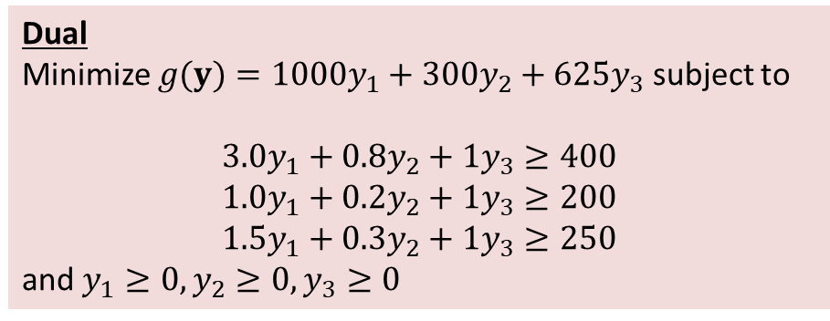
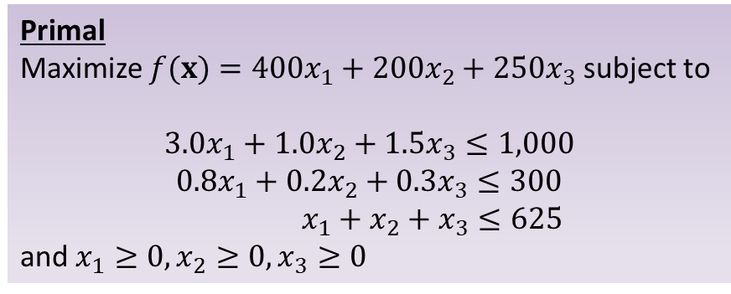
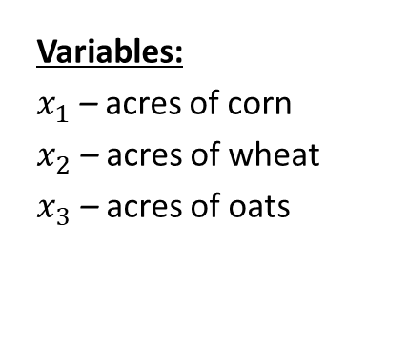
Farm Example : Dual Problem
Variables:
$x_{1}$ – acres of corn
$x_{2}$ – acres of wheat
$x_{3}$ – acres of oats
Primal
Maximize $f(x)={400x}_{1}+{200x}_{2}+{250x}_{3}$ subject to
$$3.0x_{1}+1.0x_{2}+1.5x_{3}≤1,000$$
$$0.8x_{1}+0.2x_{2}+0.3x_{3}≤300$$
$$x_{1}+x_{2}+x_{3}≤625$$
and $x_{1}≥0, x_{2}≥0, x_{3}≥0$
Variables:
$y_{1}$ – value of irrigation ($ per acre-ft)
$y_{2}$ – value of labor ($ per hr/wk)
$y_{3}$ – value of acre ($ per acre)
Dual
Minimize $g(y)={1000y}_{1}+{300y}_{2}+{625y}_{3}$ subject to
$$3.0y_{1}+0.8y_{2}+1y_{3}≥400$$
$$1.0y_{1}+0.2y_{2}+1y_{3}≥200$$
$${1.5y}_{1}+{0.3y}_{2}+{1y}_{3}≥250$$
and $y_{1}≥0, y_{2}≥0, y_{3}≥0$
Notes:
The value (revenue) of using all the materials for corn should be above 400
The value of the materials for wheat is above 300
The value of the materials used for oats should be above 250
We want to minimize our cost of all materials.

Slide 12
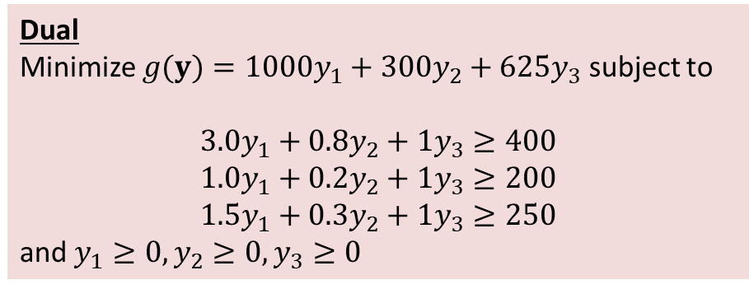
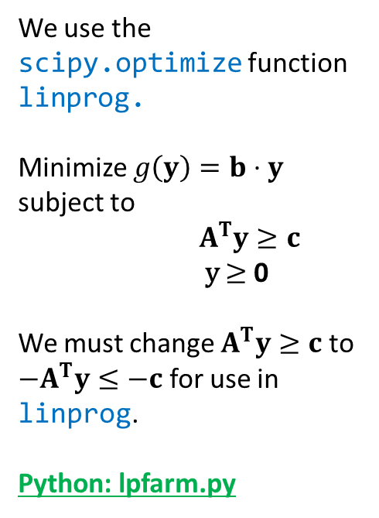
Farm Example: Solve the Dual
We use the scipy.optimize function linprog.
Minimize $g\left(y\right)=b⋅y$ subject to
$A^{T}y≥c$ y $≥$ 0
We must change $A^{T}y≥c$ to ${−A}^{T}y≤−c$ for use in linprog.
Python: lpfarm.py
Dual
Minimize $g(y)={1000y}_{1}+{300y}_{2}+{625y}_{3}$ subject to
$$3.0y_{1}+0.8y_{2}+1y_{3}≥400$$
$$1.0y_{1}+0.2y_{2}+1y_{3}≥200$$
$${1.5y}_{1}+{0.3y}_{2}+{1y}_{3}≥250$$
and $y_{1}≥0, y_{2}≥0, y_{3}≥0$
Consider the problem above
We use c = [1000, 300, 625].
b = [400,200,250] is a list of upper bounds for the constraints
A = [[3, 0.8, 1], [1.0, 0.2, 1], [1.5, 0.3, 1]] represents the matrix for the constraints.
All the variables are bounded below by 0.
Notes:
See python file section1-1pig.py

Slide 13
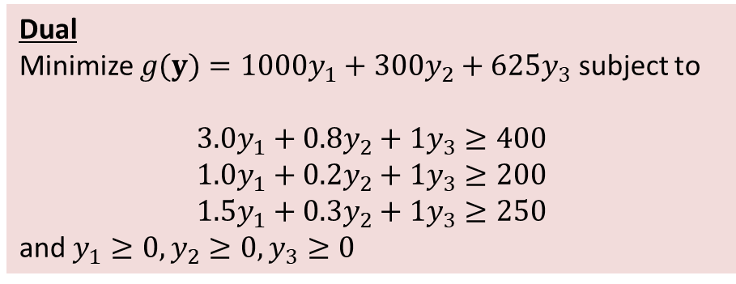
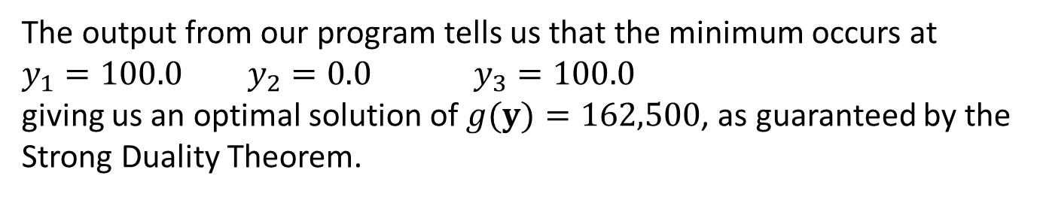
Farm Example: Dual Solution
Dual
Minimize $g(y)={1000y}_{1}+{300y}_{2}+{625y}_{3}$ subject to
$$3.0y_{1}+0.8y_{2}+1y_{3}≥400$$
$$1.0y_{1}+0.2y_{2}+1y_{3}≥200$$
$${1.5y}_{1}+{0.3y}_{2}+{1y}_{3}≥250$$
and $y_{1}≥0, y_{2}≥0, y_{3}≥0$
The output from our program tells us that the minimum occurs at
$y_{1}=100.0$ $y_{2}=0.0$ $y_{3}=100.0$
giving us an optimal solution of $g(y)=162,500$, as guaranteed by the Strong Duality Theorem.
Notes:
See python file section1-1pig.py

Slide 14
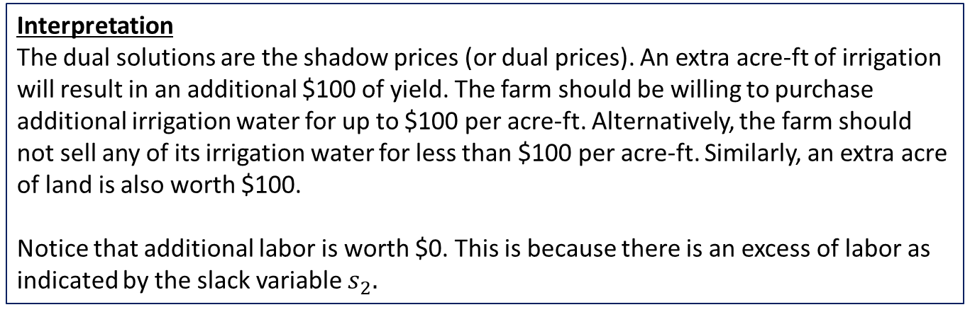
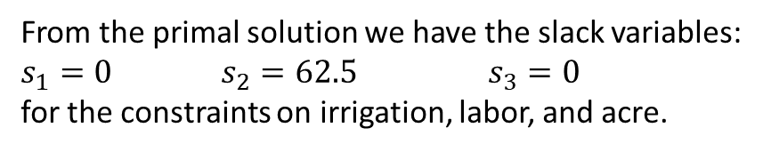
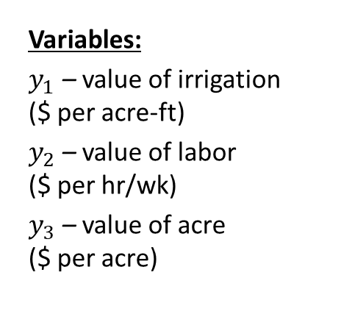
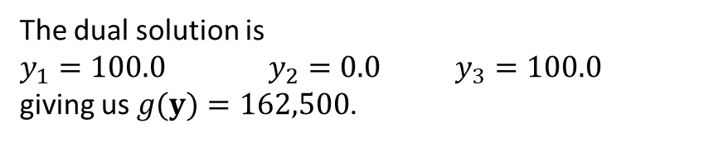
Farm Example: Shadow Prices
The dual solution is
$y_{1}=100.0$ $y_{2}=0.0$ $y_{3}=100.0$
giving us $g(y)=162,500$.
Variables:
$y_{1}$ – value of irrigation ($ per acre-ft)
$y_{2}$ – value of labor ($ per hr/wk)
$y_{3}$ – value of acre ($ per acre)
From the primal solution we have the slack variables:
$s_{1}=0$ $s_{2}=62.5$ $s_{3}=0$
for the constraints on irrigation, labor, and acre.
Interpretation
The dual solutions are the shadow prices (or dual prices). An extra acre-ft of irrigation will result in an additional $100 of yield. The farm should be willing to purchase additional irrigation water for up to $100 per acre-ft. Alternatively, the farm should not sell any of its irrigation water for less than $100 per acre-ft. Similarly, an extra acre of land is also worth $100.
Notice that additional labor is worth $0. This is because there is an excess of labor as indicated by the slack variable $s_{2}.$
Notes:
See python file section1-1pig.py

Slide 15
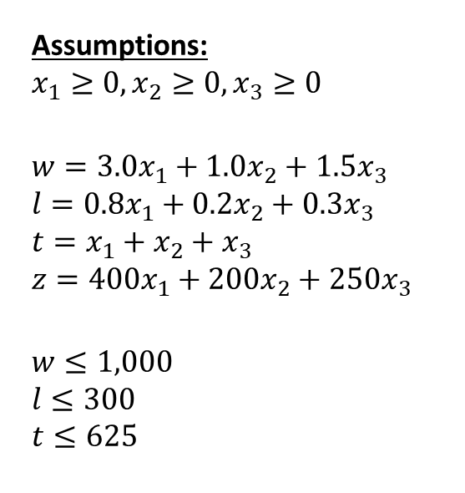
Sensitivity Analysis: Yield Amount
Assumptions:
$$x_{1}≥0, x_{2}≥0, x_{3}≥0$$
$$w=3.0x_{1}+1.0x_{2}+1.5x_{3}$$
$$l=0.8x_{1}+0.2x_{2}+0.3x_{3}$$
$$t=x_{1}+x_{2}+x_{3}$$
$$z={400x}_{1}+{200x}_{2}+{250x}_{3}$$
$$w≤1,000$$
$$l≤300$$
$$t≤625$$
Yield Parameters:
$400 – yield per acre of corn
$200 – yield per acre of wheat
$250 – yield per acre of oats
The yield per acre of each crop varies with the market. Suppose this amount changes slightly. How does this affect our solution?

Slide 16
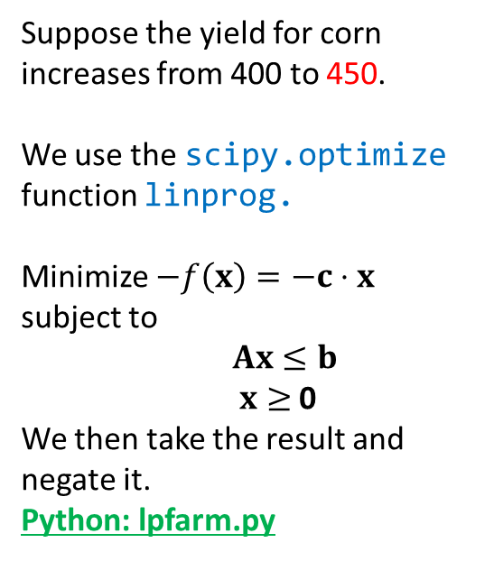
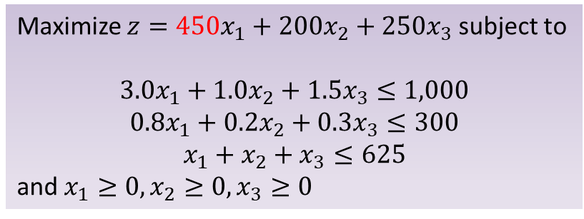
Sensitivity: Corn Yield
Suppose the yield for corn increases from 400 to 450.
We use the scipy.optimize function linprog.
Minimize $−f\left(x\right)=−c⋅x$ subject to
$Ax≤b$ $x≥$ 0
We then take the result and negate it. Python: lpfarm.py
Maximize $z={450x}_{1}+{200x}_{2}+{250x}_{3}$ subject to
$$3.0x_{1}+1.0x_{2}+1.5x_{3}≤1,000$$
$$0.8x_{1}+0.2x_{2}+0.3x_{3}≤300$$
$$x_{1}+x_{2}+x_{3}≤625$$
and $x_{1}≥0, x_{2}≥0, x_{3}≥0$
Consider the problem above
We use c = [-450,-200,-250].
b = [1000, 300, 625] is a list of upper bounds for the constraints
A = [[3, 1, 1.5], [0.8, 0.2, 0.3], [1, 1, 1]] represents the matrix for the constraints.
All the variables are bounded below by 0.
Notes:
See python file section1-1pig.py

Slide 17
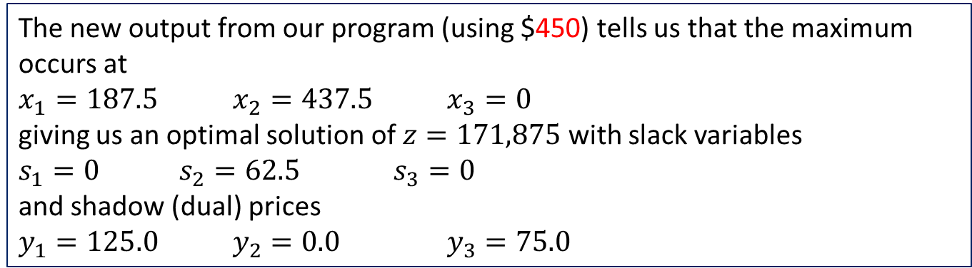
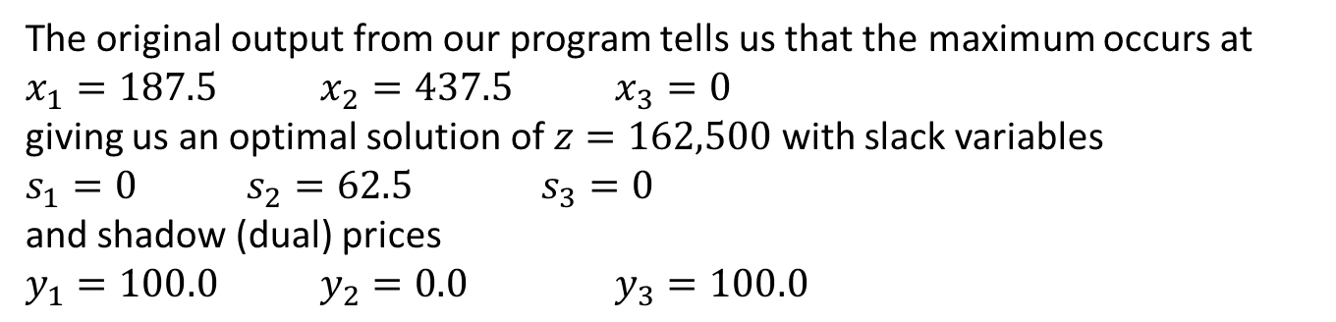
Sensitivity: Corn Yield
The original output from our program tells us that the maximum occurs at
$x_{1}=187.5$ $x_{2}=437.5$ $x_{3}=0$
giving us an optimal solution of $z=162,500$with slack variables
$s_{1}=0$ $s_{2}=62.5$ $s_{3}=0$
and shadow (dual) prices
$y_{1}=100.0$ $y_{2}=0.0$ $y_{3}=100.0$
The new output from our program (using $450) tells us that the maximum occurs at
$x_{1}=187.5$ $x_{2}=437.5$ $x_{3}=0$
giving us an optimal solution of $z=171,875$with slack variables
$s_{1}=0$ $s_{2}=62.5$ $s_{3}=0$
and shadow (dual) prices
$y_{1}=125.0$ $y_{2}=0.0$ $y_{3}=75.0$
Notes:
See python file section1-1pig.py

Slide 18
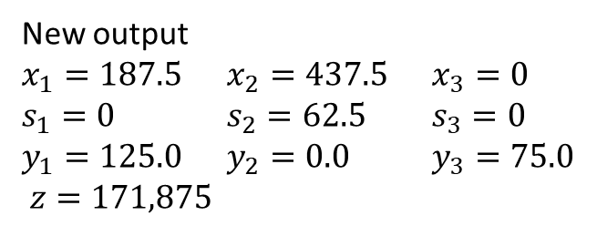
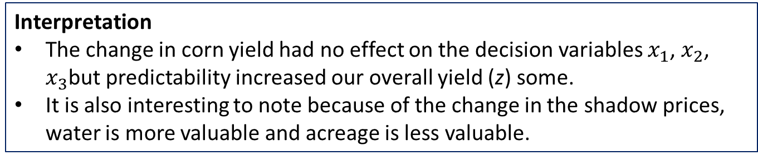
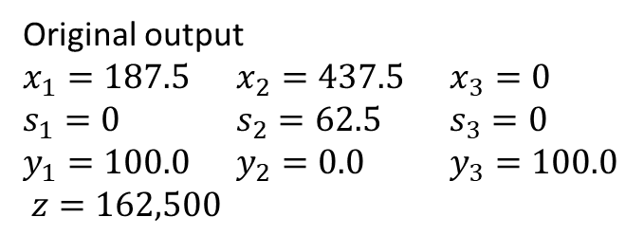
Sensitivity: Corn Yield (Comparison)
Original output $x_{1}=187.5$ $x_{2}=437.5$ $x_{3}=0$
$s_{1}=0$ $s_{2}=62.5$ $s_{3}=0$
$y_{1}=100.0$ $y_{2}=0.0$ $y_{3}=100.0$
$z=162,500$
New output $x_{1}=187.5$ $x_{2}=437.5$ $x_{3}=0$
$s_{1}=0$ $s_{2}=62.5$ $s_{3}=0$
$y_{1}=125.0$ $y_{2}=0.0$ $y_{3}=75.0$
$z=171,875$
Interpretation
The change in corn yield had no effect on the decision variables $x_{1}$, $x_{2}$, $x_{3}$but predictability increased our overall yield (z) some.
It is also interesting to note because of the change in the shadow prices, water is more valuable and acreage is less valuable.
Notes:
See python file section1-1pig.py

Slide 19

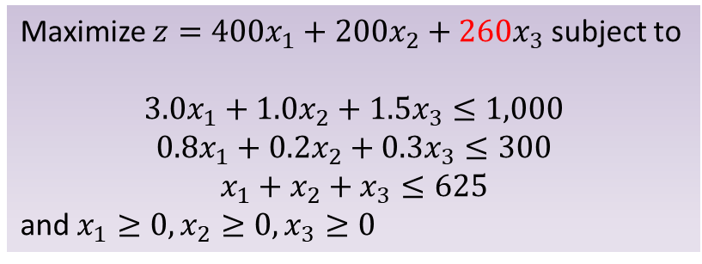
Sensitivity: Oat Yield
Suppose the yield for oast increases from 250 to 260.
We use the scipy.optimize function linprog.
Minimize $−f\left(x\right)=−c⋅x$ subject to
$Ax≤b$ $x≥$ 0
We then take the result and negate it. Python: lpfarm.py
Maximize $z={400x}_{1}+{200x}_{2}+{260x}_{3}$ subject to
$$3.0x_{1}+1.0x_{2}+1.5x_{3}≤1,000$$
$$0.8x_{1}+0.2x_{2}+0.3x_{3}≤300$$
$$x_{1}+x_{2}+x_{3}≤625$$
and $x_{1}≥0, x_{2}≥0, x_{3}≥0$
Consider the problem above
We use c = [-400,-200,- 260].
b = [1000, 300, 625] is a list of upper bounds for the constraints
A = [[3, 1, 1.5], [0.8, 0.2, 0.3], [1, 1, 1]] represents the matrix for the constraints.
All the variables are bounded below by 0.
Notes:
See python file section1-1pig.py

Slide 20
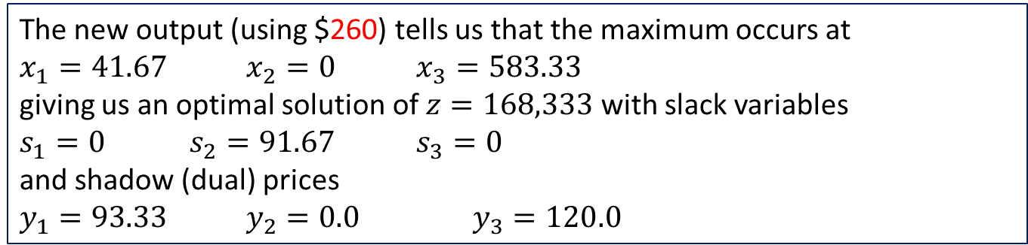
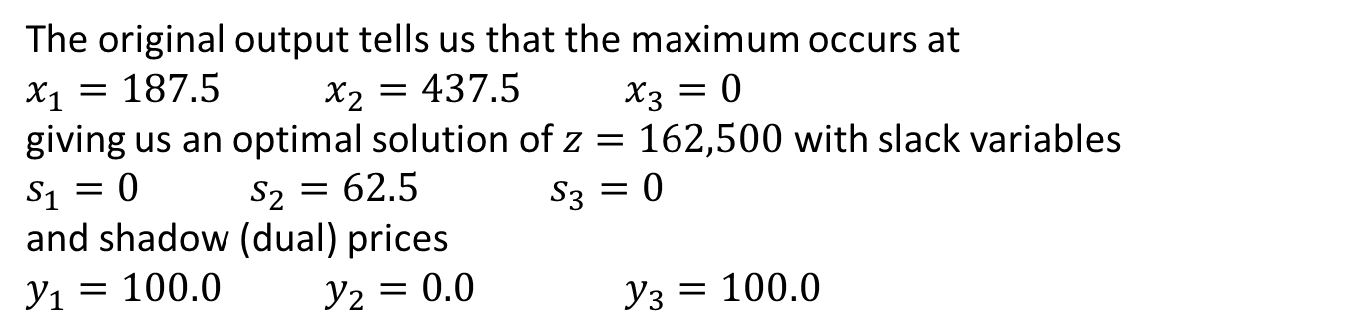
Sensitivity: Oat Yield
The original output tells us that the maximum occurs at
$x_{1}=187.5$ $x_{2}=437.5$ $x_{3}=0$
giving us an optimal solution of $z=162,500$with slack variables
$s_{1}=0$ $s_{2}=62.5$ $s_{3}=0$
and shadow (dual) prices
$y_{1}=100.0$ $y_{2}=0.0$ $y_{3}=100.0$
The new output (using $260) tells us that the maximum occurs at
$x_{1}=41.67$ $x_{2}=0$ $x_{3}=583.33$
giving us an optimal solution of $z=168,333$with slack variables
$s_{1}=0$ $s_{2}=91.67$ $s_{3}=0$
and shadow (dual) prices
$y_{1}=93.33$ $y_{2}=0.0$ $y_{3}=120.0$
Notes:
See python file section1-1pig.py

Slide 21
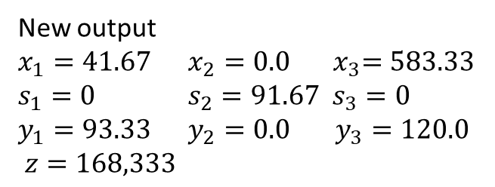
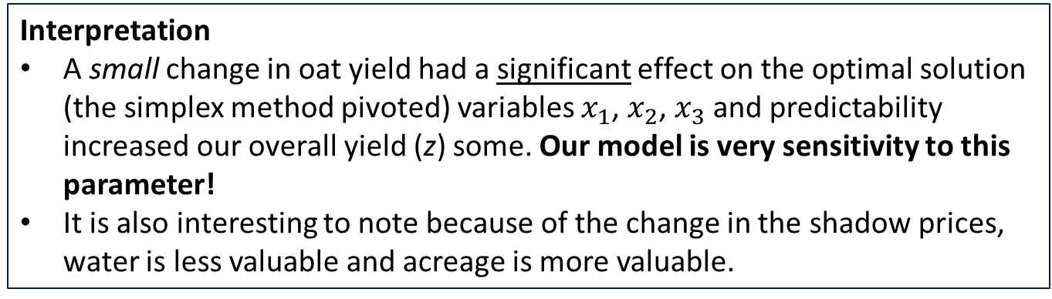
Sensitivity: Oat Yield (Comparison)
Original output $x_{1}=187.5$ $x_{2}=437.5$ $x_{3}=0$
$s_{1}=0$ $s_{2}=62.5$ $s_{3}=0$
$y_{1}=100.0$ $y_{2}=0.0$ $y_{3}=100.0$
$z=162,500$
New output $x_{1}=41.67$ $x_{2}=0.0$ ${ x}_{3}=583.33$
$s_{1}=0$ $s_{2}=91.67 s_{3}=0$
$y_{1}=93.33$ $y_{2}=0.0$ $y_{3}=120.0$
$z=168,333$
Interpretation
A small change in oat yield had a significant effect on the optimal solution (the simplex method pivoted) variables $x_{1}$, $x_{2}$, $x_{3}$ and predictability increased our overall yield (z) some. Our model is very sensitivity to this parameter!
It is also interesting to note because of the change in the shadow prices, water is less valuable and acreage is more valuable.
Notes:
See python file section1-1pig.py

Slide 22
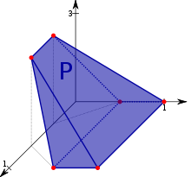
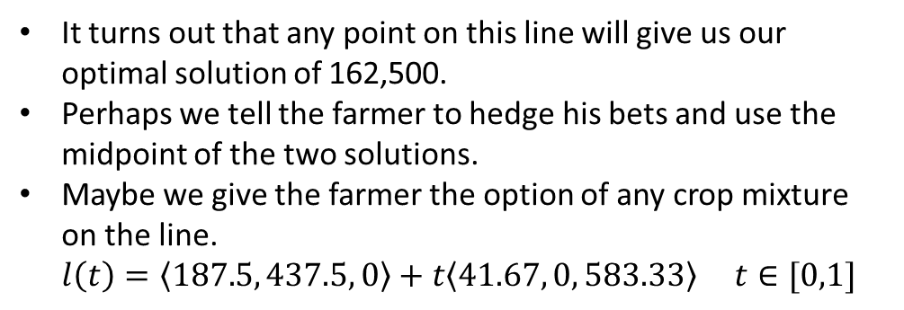
Notes on Sensitivity and Robustness
A small variation in yield changes our optimal decision.
Practically, we don’t really know if we should tell the farmer to plant oats or wheat.
Since our two solutions are on the boundary of the feasible region that must be connected by a straight line. (187.5, 437.5, 0) (41.67, 0, 583.33)
(114.58, 218.75, 291.67)
It turns out that any point on this line will give us our optimal solution of 162,500.
Perhaps we tell the farmer to hedge his bets and use the midpoint of the two solutions.
Maybe we give the farmer the option of any crop mixture on the line. $l\left(t\right)=〈187.5, 437.5, 0〉+t〈41.67, 0, 583.33〉 t∈[0,1]$
Ex. Feasible Region (not this problem)

Slide 23
Up Next: Integers
We just presented several possible “solutions” to the previous problem. In particular, we have the two extreme points and the midpoint of these
(187.5, 437.5, 0) (41.67, 0, 583.33)
(114.58, 218.75, 291.67)
However, what if the farmer cannot (or will not) divide up his acres? That is, the former cannot plant 0.5 acre of corn and 0.5 acres of wheat. Each acre can only contain one crop.
Thus, our solutions must be integers. How does this change the problem?

